Slide 1
Python Project
Server Task Manger
Huihuang Li, Yuli Zhang, Jian Wang, Yijiang Huang, Yan Wei
20150128

Slide 2
User
Password
Server
Disk
OK
Cancel

Slide 3
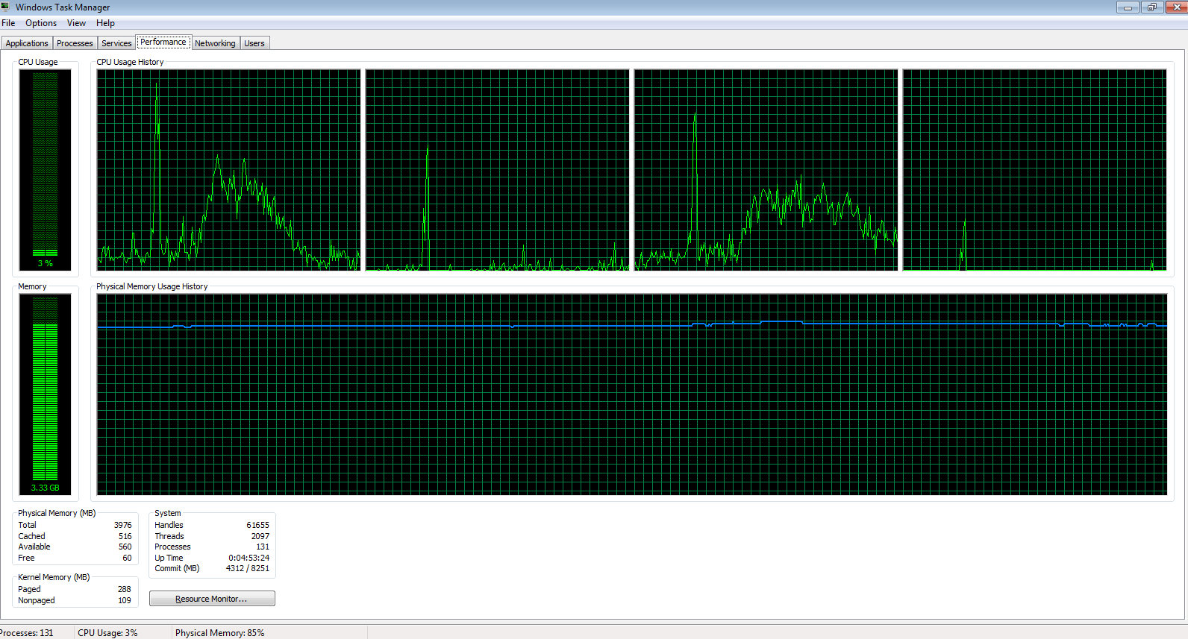

Slide 4
Server loading checking
Whose process on the server , loading?
Disk email

Slide 5
Q&A

